Slide 1
Elder Law & Estate Planning
By David R. Okrent, CPA, Esq.
The Law Offices of David R. Okrent
www.okrentlaw.com
Available for consultation call 631-427-4600

Slide 2
Honors and Awards of David R. Okrent Esq., CPA
Mr. Okrent is a CPA and an attorney, with prior experience at both KPMG Peat Marwick and the IRS as a Revenue Agent and has more than 39 years experience.
He is the recipient/honored by
  The Long Island Coalition for the Aging, Inc. " Man of Spirit" Award in 2006,
  L.I. Herald’s Top Attorney Award in 2023 in the field of Elder Law,
  The Long Island Alzheimer Foundation as "Angel of Spirit,”
  Day Haven Adult Day Services,
  The Long Island Business News, &
  Appointed by Governor Hochul to the New York State Coordinating Council for Services Related to Alzheimer’s Disease and Other Dementia
Suffolk County Bar Association an immediate Past Board of Director, Managing Director of its Charity Foundation, & Co-Chair of the Elder Law Committee.
Member of the Executive Committee of the NYS Bar Association’s Elder Law Section and Vice-Chair of its Estate and Tax Planning Committee.
Board Member of the NY Chapter of the National Academy of Elder Law Attorneys

Slide 3
The 10 Most Common Mistakes in
Elder Law & Estate Planning
The Law Offices of David R. Okrent
No Estate Plan & Beneficiary Designation Wrong/Missing
No Documents or they are Outdated
The Wrong Executor/Trustee/Agent in POA and HCPOA
Failure to:
  Fund/Coordinate Living Trust and Assets
  Execute Power of Attorney w/Gift Giving Provisions
  Sign Documents and complete Will
  Properly Insure Assets inside a Living Trust
  Consider Income Tax Impact of Estate as well Estate Tax
  Plan for Long Term Care
  Consult with Qualified Professionals

Slide 4
Type of Long-Term Care and Cost
The Law Offices of David R. Okrent
Home Care
Day Care
  Social Model
  Medical Model
Assisted Living
Nursing Home

Slide 5
How Will the Care be Paid for?
Medicare
  Skilled Nursing Facility day 81-100 Copayment $209.50
Private Pay
Long Term Care Insurance
Medicaid

Slide 6
Medicaid Limits for a Single Person
Income
  $50 a month under Institutional Medicaid
  $1,800 a month under Community Medicaid
    However, more can be kept under Community Medicaid for any type of expenses with a “Pooled Income trust”
Resources
  $32,396 in non-qualified assets
  Unlimited amounts in certain *tax qualified retirement accounts in a Medicaid pay status (*may be subject to recovery)
  Prepaid funeral
  A Home…….see next slide for important details

Slide 7
Medicaid and the Home
The Law Offices of David R. Okrent
Equity in the Home must be equal to or less than $1,097,000, unless occupied by a
  Spouse
  Child under the age of 21, or
  Child certified blind or disabled
Intent to return home
Purchase of a Life Estate in the home of another

Slide 8
Community Medicaid & Married Couples
One Applying :
  Resources:
    Home - Applicant subject to limits but Non-Applying Spouse No limit
    Other Resources:
      Applicant $32,396, Spouse between $74,820 – $157,920, Spousal Refusal
      Unlimited $$ in certain Tax-Qualified-Retirement accounts in pay status
      Be careful with annuities
  Monthly Income
    $4,567 combined (Applicant $619, Non-Applying spouse $3,948)
    Spousal Refusal
    Pooled Trust
Both Applying
  Resources: Home is subject to the limit, retirement accounts in
  pay status are exempt, plus $43,781
  Income: $2,433 + Pooled Trust
CDPAP is changing April 1, 2025.

Slide 9
Nursing Home:
Medicaid and the Married Couple
The Law Offices of David R. Okrent
Resources:
  Applicant:
    Basic $32,396 and unlimited amounts in certain Tax-Qualified-Retirement accounts in pay status
    Be careful with annuities
  The Community Spouse is permitted:
    A Home of any value
    Basic $74,820 – $157,920 and unlimited amounts in certain Tax-Qualified-Retirement accounts in pay status
    Be careful with annuities
Monthly Income - Applicant $50 and Spouse $3,948
Spousal Refusal

Slide 10
Transfer of Assets & the 5 Year Rule
The 5 Year Lookback Rule:
  Primarily only applies to applications for Institutional/Nursing Home Medicaid
  Does not apply:
    To Community Medicaid (YET - What about 10/1/2020?)
      October 1, 2020 – 30 month look back and penalty for transfers on hold
    If there is a transfer exemption, e.g. transfer to spouse, caretaker child, etc.
If Applying for Nursing Home Medicaid and within the 5 year look back there are transfers, then for every $14,914 (Long Island Rate) the person transferred they are ineligible for Institutional/Nursing Home Medicaid for one month.

Slide 11
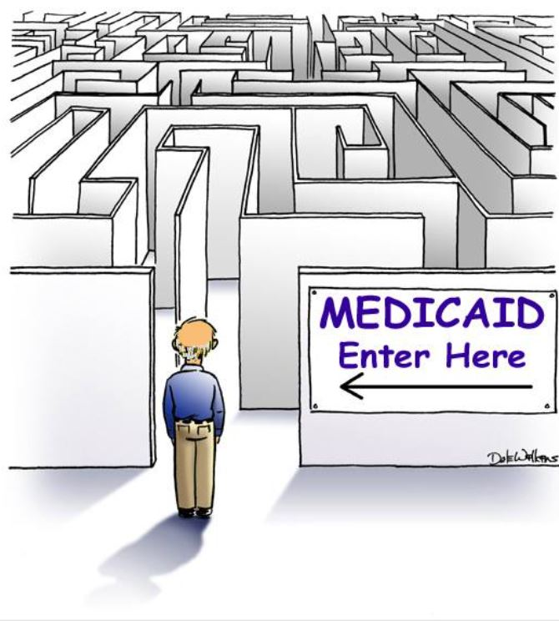
Medicaid at its Best!

Slide 12


Slide 13
NYS Coordinating Council for Alzheimer’s Disease and Other Dementia
The New York State Coordinating Council for Services Related to Alzheimer's Disease and Other Dementias (Council) was established by Public Health Law § 2004-a (enacted by Chapter 58 of the Laws of 2007, Part B, § 24). The Council was created to facilitate interagency planning and policy-making, review specific agency initiatives for their impact on services related to the care of persons with dementia and their families, and provide a continuing forum for concerns and discussions related to the formulation of a comprehensive state policy for Alzheimer's disease (AD).
The Council is charged with providing periodic reports to the Governor and the Legislature. The reports must set forth the Council´s recommendations for state policy relating to dementia and include a review of services initiated and coordinated by public and private agencies to meet the needs of persons with Alzheimer's disease and related dementias and their families, this report provides a beginning to this review.

Slide 14
NYS Coordinating Council for Alzheimer’s Disease and Other Dementia
“BOLD”
  The Federal Government’s Building Our Largest Dementia Infrastructure for Alzheimer’s Act (P.L.115-406) 12/13/18 (referred to as “BOLD”) to support a public health approach to prevention, treatment, & care of Alzheimer’s disease and related dementia. Authorizing the CDC to:
    1) Establish Public Health Centers of Excellence dedicated to promote the best ways to effectively manage Alzheimer’s disease and related dementia & support caregivers (of which Stony Brook University Hospital has been selected),
    2) Work with state, local, and tribal public health departments to promote brain health, strategies to reduce cognitive decline and care for individuals with Alzheimer’s disease and related dementia, and
    3) Improve the analysis and timely reporting of data on Alzheimer’s disease and related dementia, cognitive decline, caregiving and health disparities at both a state and national level.
  States with more developed programs, such as New York with structure in place, are expanding focus on early detection and diagnosis of ADRD.

Slide 15
Federal 2025 Estate & Gift Tax Numbers
The Law Offices of David R. Okrent
Exemption 2025 is $13,990,000 per person.
    Sunsets back to $5,000,000 12/31/25 with inflation.
Annual Exclusion 2025 is $19,000
    $190,000 to a spouse who is not a citizen of the United States 2025.
    Recipients of gifts from certain foreign persons are required to report gifts under §6039F if aggregate value of gifts received in a taxable year exceeds $19,570.

Slide 16
Federal Estate & Gift Tax: The Anti- Clawback Regulations
On 11/26/2019, the IRS issued Final regs under Sec. 2010 protect gifts made before 2026 (TD 9884; Reg §20.2010‐1; Reg §20.2010‐3; IR 2019‐189 ) providing a “special rule,” that ensured that a decedent's estate would not be inappropriately taxed with respect to gifts that were sheltered from gift tax by the increased Basic Exclusion Amount (“BEA”) when made.
On 4/26/2022, the IRS released new proposed regulations limiting the 2019 anti-clawback regulations to address situations in which an estate could be taxed on gifts made by a donor after 2017 and before a reduction in the BEA, wherein the gifts were free of gift tax when made.

Slide 17
NY Estate and Gift Tax
For 2025 the Basic Exclusion amount is $7,160,000, Top Rate 16%.
There is No NYS Gift Tax, but Estate must include Gifts made in prior 3 Years.
    3 Year Gift Inclusion Lookback ends for decedent dying on or after 1.1.2026. NY CLS Tax §954(a)(3).
    Governor’s 25-26 Budget includes provision to continue this 3 year lookback.
No portability in NYS, so still need credit shelter style planning.
“Cliff “: Lose exemption if estate >exemption by 5% (>$7,518,000 in 2025).
Cliff Planning by use of a “Santa Clause:”
        Net Estate $7,260,000 $ 7,260,000
        Amount to charity _ -0- ($100,000)
        Net $ 7,260,000 $7,160,000
        Tax $ 262,535 -0-
        Net to Family $ 6,997,465 $7,160,000
        Savings $162,535 in tax & increase to family

Slide 18
Disregarded SMLLC with N.Y. Real Property is Included in N.Y. Taxable Estate
  TSB-A-15(1)M Estate Tax May 29, 2015
  [Is]…a membership interest in a single-member LLC (SMLLC), that is disregarded for income tax, is also disregarded for New York State estate tax purposes.
  Pursuant to 26 CFR §§ 301.7701-2, …“A business entity with only one owner is classified as a corporation or is disregarded; if the entity is disregarded, its activities are treated in the same manner as a sole proprietorship, branch, or division of the owner.” 26 C.F.R. § 301.7701-2(a). Then, per 26 C.F.R. § 301.7701-3(a) an entity with a single owner is disregarded as an entity separate from its owner unless it elects to be classified as an association..26 C.F.R.§ 301.7701-3(c)(1)(i).
  Based on the above analysis, where a SMLLC is disregarded for Federal income tax, it is treated as owned by the individual owner and the activities of the SMLLC are treated as activities of the owner. Therefore, … an interest in the SMLLC … would not be treated for NY estate tax purposes as an intangible asset, instead, condominium held by SMLLC would be treated as real property held by the decedent for New York State estate tax purposes.

Slide 19
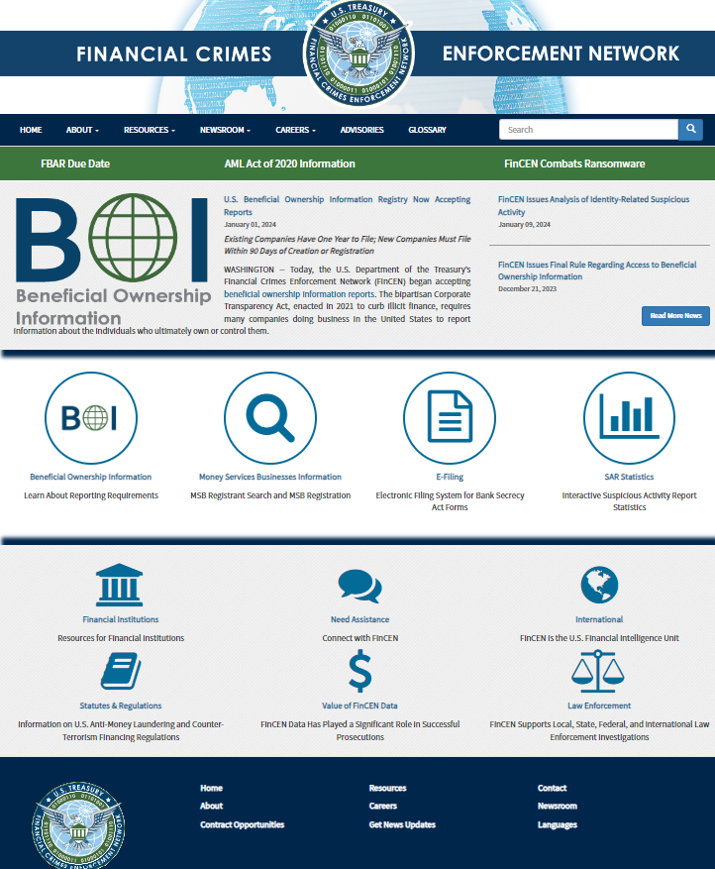
The Law Offices of David R. Okrent
Beneficial Ownership Reporting Requirement
www.Fincen.gov

Slide 20
Federal Income Tax
Capital gains.
  The 15% rate: above $96,700 for married joint and $48,351 for individuals and $3,250 for trusts and estates.
  The 20% rate: Above $600,050 for married joint and $533,400 for individuals and $15,900 for trust and estates.
Alternative minimum tax (AMT) for individuals, kept the tax, but increased the exemption. The AMT exemption amount is now $137,000 for married joint and half for married separate, $88,100 for individuals. The exemption is reduced by $1 for every $4 above $1,252,700 for married joint, $626,350. For corporations it has been repealed.
The exemptions and phaseouts were significantly increased under the TJCA. Without Congressional action, they’ll drop to their pre-TCJA levels (adjusted for inflation) in 2026.
Trusts and Estates brackets are compressed and reach 37% at $15,650 of income.
  Grantor Trust Rules (See Rev. Rul. 85-131985-1 C.B. 184) treat grantor as the owner of the trust for income tax purposes, and therefore taxed on individuals return and rates, etc. Instructions to 1041 give reporting options, and how to use Grantor’s Tax Identification Number for the trust.

Slide 21
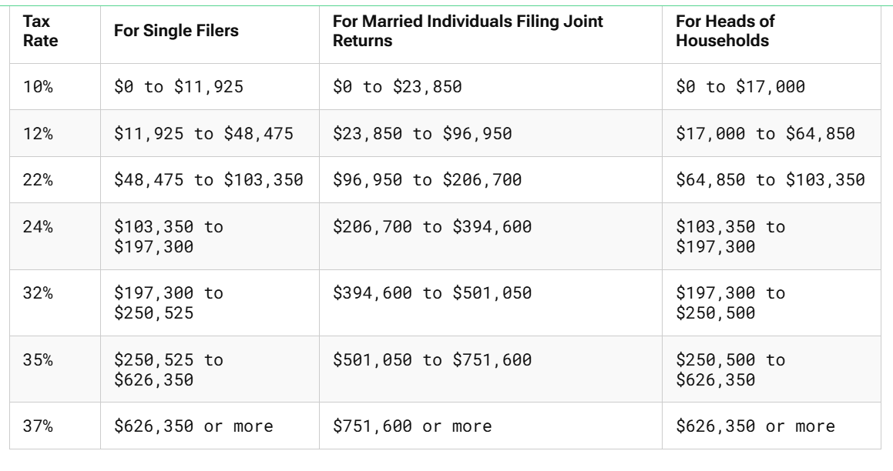
Federal Income Tax
Tax brackets, tax rates change and Alternative Minimum Tax.

Slide 22
Federal Income Tax
Personal and dependent exemptions are eliminated in accordance with the Tax Cuts and Jobs Act of 2017 (TCJA).
Standard deduction increases - $15,000 for a single taxpayer, $22,500 for a head of household taxpayer and $30,000 for taxpayers who file jointly, and the additional standard deduction amount for the aged or the blind is $2,000 if single or head of household and $1,600 if married.

Slide 23
Federal Income Tax
Itemized deductions eliminated, limited or modified
  Miscellaneous itemized deductions eliminated
  Eliminated Employee business expenses, including Tax preparation fees, Investment interest expenses.
  Eliminated Personal casualty and theft losses (except for certain losses in certain federally declared disaster areas).
  State and local income taxes total $10,000 ($5,000 if MFS).
  Home mortgage interest new home mortgage is limited to interest on a maximum of $750,000 ($375,000 if Married filing separately) and not on home equity Loans unless used to improve home.
  Charitable contributions: When you donate cash to a public charity, the general deduction is up to 60% of adjusted gross income. Appreciated assets held for >1 year are generally deductible at fair market value, up to 30% of adjusted gross income.
  Gambling Losses any otherwise allowable deduction incurred

Slide 24
Federal Income Tax
The Law Offices of David R. Okrent
Itemized deductions eliminated, limited or modified (continued)
  Medical expenses threshold for 2025 is 7.5% of AGI.
    Home Care
    Assisted Living – (part of cost - consult with Assisted Living Facility)
    Long Term Care Insurance – Qualified Plan
      New York permits a credit for 20% of premium paid for qualifying long term care insurance, with a maximum of $1,500.00 and AGI is below $250,000
      Federal Deduction:
Attained age before end of Year | Maximum deduction for year
40 or less | $480
More than 40 but not more than 50 | $900
More than 50 but not more than 60 | $1,800
More than 60 but not more than 70 | $4,810
More than 70 | $6,020

Slide 25
Inheriting IRA’s and Retirement Plans & the “SECURE” Act: 10 year pay out with exceptions
In 2019:
  On December 20,2019, the “Further Consolidated Appropriations Act, 2020 (H.R. 1865)” included the Setting Every Community Up for Retirement Enhancement Act of 2019 (the “SECURE Act”) was enacted. The Act included changes regarding retirement age, retirement plan access and lifetime income options in retirement plans.
In 2022:
  On 2/24/22 the IRS issued Proposed Regulations.
  The IRS has issued Notices which waives the 50% penalty for RMD shortfalls by beneficiary who inherited from an owner who died after their RBD.
  On 12/29/22 “SECURE Act 2.0,” contained in Division T of the 2023 Consolidated Appropriations Act (a/k/a CCA, a/k/a Omnibus Bill), H.R.2617, became law further modifying.
In 2024:
  Final regulations for distributions from retirement plans and IRAs, including implementation of changes made by the SECURE Act (and some changes by the SECURE 2.0 Act) were released July 18, 2024, (Federal Register July 19, 2024)

Slide 26
Consider a Charitable Remainder Unitrust as a Beneficiary for the IRA
Beneficiary | Amount of Ultimate Inheritance
Child receives $600,000 IRA result after 20 years
Withdraws in year 10, pay tax and reinvest for additional 10 years | $1,099,217
Child receives $600,000 from 20 year “CRUT”
Child gets | $1,415,979
Charity gets | $ 293,177
Total | $1,709,156
  *For illustration purposes prepared using 2022 numbers with a $600,000 IRA.

Slide 27
Qualified Charitable Distribution (“QCD”) IRC 408(d)(8) & Secure 2.0
Allows taxpayers age 70½ and older to transfer up to $108,000 annually from their IRA directly to a qualified charity without having to recognize the income. For those 73 and older the distribution also counts towards this years RMD.
The SECURE Act did not change this.
Not permitted to transfer to donor-advised funds, supporting organizations or private foundations.
Under the SECURE Act, QCDs need to be reduced by any post-age 70 ½ IRA contributions.
Section 307, One-time election for qualified charitable distribution to split-interest entity; increase in qualified charitable distribution limitation. Section 307 expands the IRA charitable distribution provision to allow for a one-time, $50,000 distribution to charities through charitable gift annuities, charitable remainder unitrusts, and charitable remainder annuity trusts.

Slide 28
Donating Crypto Of $5,000 Or More Requires Qualified Appraisal
The Law Offices of David R. Okrent
Unlike publicly traded securities, a donation of cyrpto currency that exceeds $5,000 will require a qualified appraisal. Wait, aren’t crypto currencies actively traded, with the ups and downs of their prices making headlines? The answer is that neither the IRS nor the SEC has taken any official position to treat cryptocurrencies as securities. In fact, the IRS has designated cryptocurrency as property and not currency.
  A “qualified appraisal” must meet IRS requirements, who is an appraiser who has met education & experience requirements and are usually licensed/certified in state where property is located.
  Appraisal must be no more than 60 days prior to the donation & no later than due date of tax return including extensions. The appraisal is reported on Form 8283.
  It can be challenging to find a crypto appraiser, investors may turn to their financial institutions, advisor, charities or donor advised funds and planned giving resources as a resource.
Confirmed in Ruling of 1st impression by IRS Office of Chief Counsel
  Internal Revenue Service Memorandum Number: 202302012 Release Date: 1/13/2023 – Failure to obtain a qualified appraisal will result in a denial of a Charitable Deduction

Slide 29
The Law Offices of David R. Okrent
Estate Planning Considerations 2025
Gift more then $6,995,000, to use the extra “Basic Exclusion Amount.“
Outright Gifts.
Spousal Lifetime Access Trust (SLAT).
Split Gifts.
Use Business entities to transfer certain assets.
GST Planning.
Topping Off Gifts.
Review Formula Bequests.
Insure Adequate Disclosure Reporting on Gift Tax Returns.
Consider Ensuring Your Estate Has Sufficient Liquidity.
Use a Defective “Grantor” Trusts.
Consider the Basis Adjustment and "upstream planning.“
Charitable Giving.

Slide 30
NY Governor’s 2024-2025 Budget Creates “Transfer on Death Deeds” in New York, Exercise Caution!
The NY Governor’s 2024-2025 budget contained a new section of the Real Property Law in New York, Section 424 authorizing Transfer-On-Death Deed(s) for New York real property (See Governor’s budget, Art. VII, Part O, sec. 12).
See our blog on our website at:
  https://okrentlaw.com/ny-governors-2024-2025-budget-creates-transfer-on-death-deeds-in-new-york-exercise-caution/

Slide 31
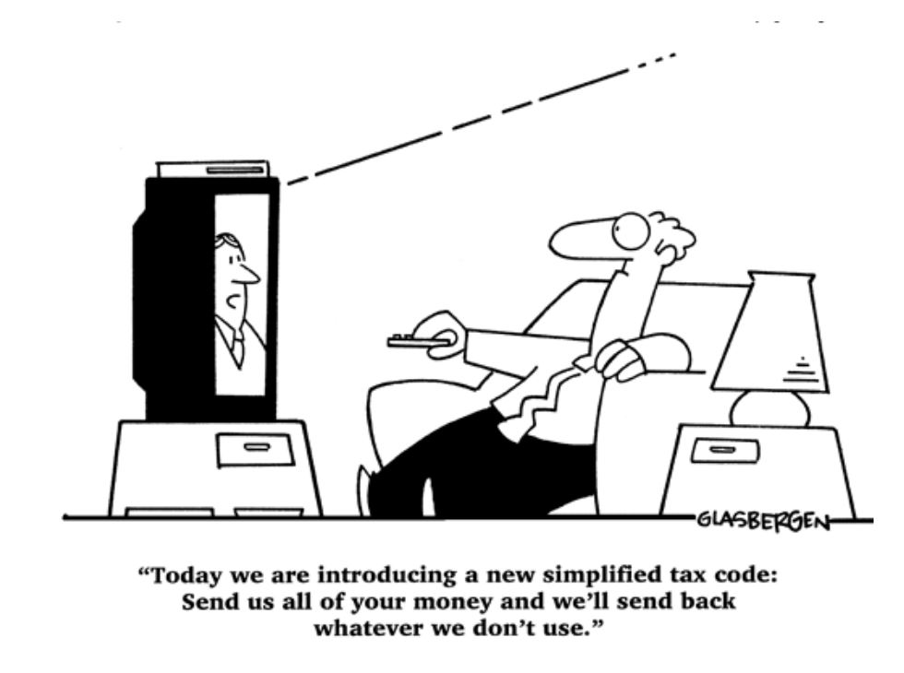
A The New Method of Taxation ….
The Law Offices of David R. Okrent

Slide 32
Famous Tax Quotes:
The Law Offices of David R. Okrent
Ronald Reagan -"The taxpayer: that’s someone who works for the federal government but doesn’t have to take a civil service examination.“
Albert Einstein - "The hardest thing in the world to understand is the income tax.“
Morgan Stanley advertisement - “You must pay taxes. But there’s no law that says you gotta leave a tip.“
Will Rogers - “The difference between death and taxes is death doesn’t get worse every time Congress meets.“

Slide 33
A & A Veteran’s Benefit
The A&A Pension can provide up to $2,385 per month to a veteran, $1,515 per month to a surviving spouse, or $2,795 per month to a couple (if both are veterans $3,740.50).
Any War-Time Veteran with 90 days of active duty.
To qualify medically, Veteran or Surviving Spouse requires assistance of another person to help with activities of daily living
Deductible Medical Expenses include:
  Payments for meals, lodging, health care, custodial care and other services provided by a facility (assisted living, independent living, etc.) are deductible medical expenses as long as the Veteran:
  Resides in a facility that is staffed 24 hours/day
  Needs assistance with 2 Activities of Daily Living (ADLs)
  An in-home attendant with health care or custodial care.

Slide 34
A & A Veteran’s Benefit
Net Worth:
  Asset limit: $155,356 in year 2025
  Net worth includes monthly income multiplied by 12 and added to total.
  Certain medical expenses can be deducted from income (see below).
Look-Back and Penalty Periods for transfers after October 18, 2018:
  36 Month look-back period.
  Applicant can return assets and un-do a penalty period (in whole or in part)
  within 60 days of a penalty period decision.
  Penalty period cannot exceed 5 years.
  Transfers to a trust for a disabled child will not be penalized.
Real Property
  Primary residence is excluded from net worth
  Acreage limit: Primary residence plus 2 acres is excluded. Additional acreage
  will be counted toward net worth unless it is unmarketable.
  Proceeds from the sale of real property, after benefit entitlement, are not counted as long used to purchase another property in the same year.

Slide 35

Advance Directives
The Law Offices of David R. Okrent
Financial
Powers of Attorney
Trusts
Medical
Healthcare Proxy
Molst
Guardianship
Living Will
FHCDA
“Care Act”
  Article 81
  SCPA 17A

Slide 36
Methods of Protecting Assets
The Law Offices of David R. Okrent
OUTRIGHT GIFTS
LIFE ESTATES
TRUSTS

Slide 37
Okrent’s Transfer Matrix
The Law Offices of David R. Okrent
 | Outright Gift | Life Estate | Irrevocable Trust
Medicaid Penalty | 5 year Maximum | 5 year Maximum | 5 year Maximum
Tax Issues
Property
Star | Lost | Keep | Keep*
Veterans | Lost | Keep | Keep*
Income
Capital Gain Exclusion | Lost | Part | Keep
Step up in Basis | Lost | Keep | Keep
Lifetime Sale Protection | None | Part | All
Control | Lost | Part | Keep
Recovery | None | None | None

Slide 38
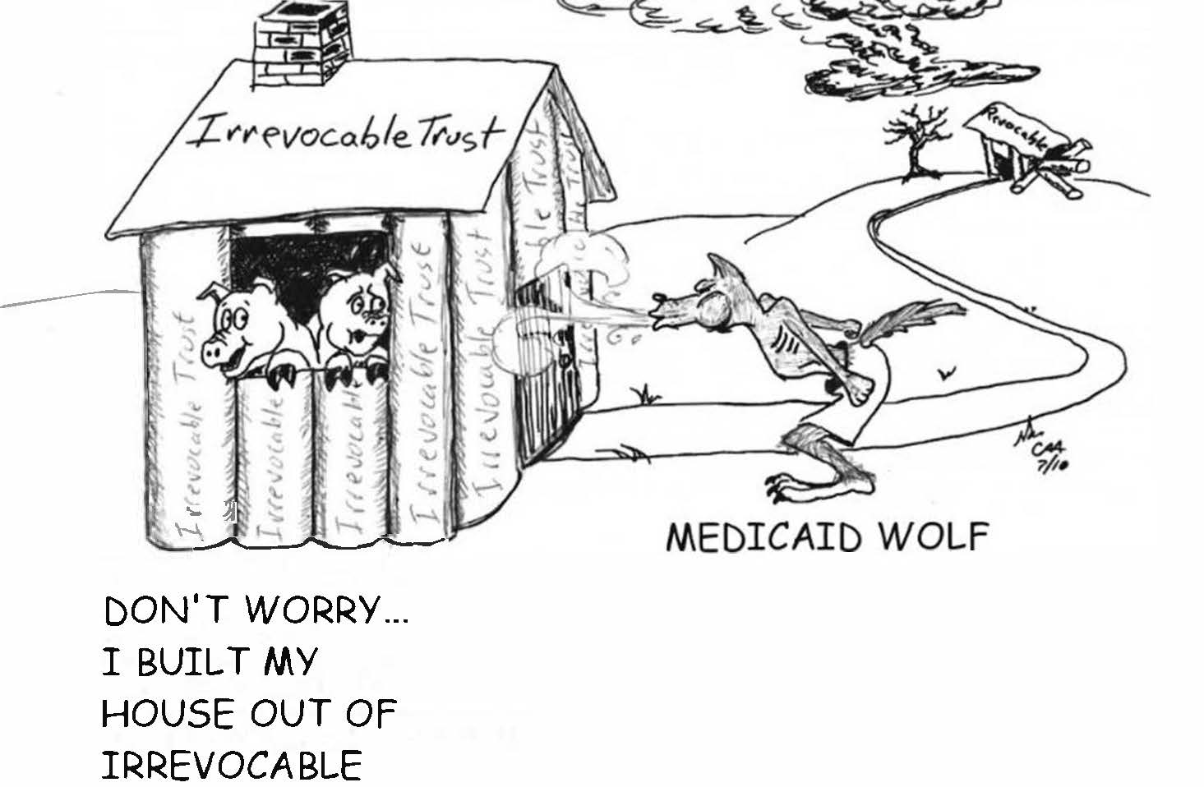
Irrevocable vs. Revocable
The Law Offices of David R. Okrent

Slide 39

Thank you for your attendance and I hope this was Webinar was helpful…
We are available for Individual Consultations
The Law Offices of David R. Okrent
By David R. Okrent, CPA, Esq.
The Law Offices of David R. Okrent
dave@okrentlaw.com
www.okrentlaw.com
631-427-4600

